Slide 1

Is it possible to predict whether a film will succeed according to the movie cast features?
Data Mining and Machine learning
Tsach Yashar
Dvir Harazi

Slide 2
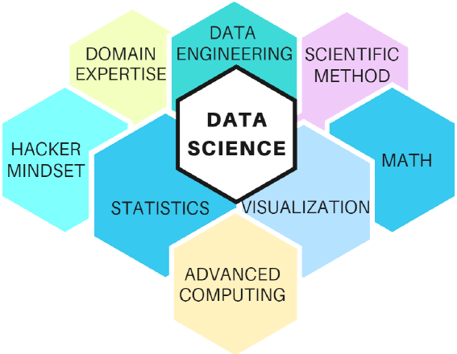
Our research - intro
Research questions:
Can we predict which movie will succeed according to the certain properties? (Actors, directors, Length of movie etc..)

Slide 3

Research process- Data Acquisition
We do 3 different crawling
Used a function from ‘pandas’ to crawl the list of all the American movies from Wikipedia.
Search for every movie from Wikipedia list in IMDB with selenium automation and take the details (Director, Actors, Genre, Rating, Movie length)
We search most of the Females from the movie world and crawl from different sites

Slide 4
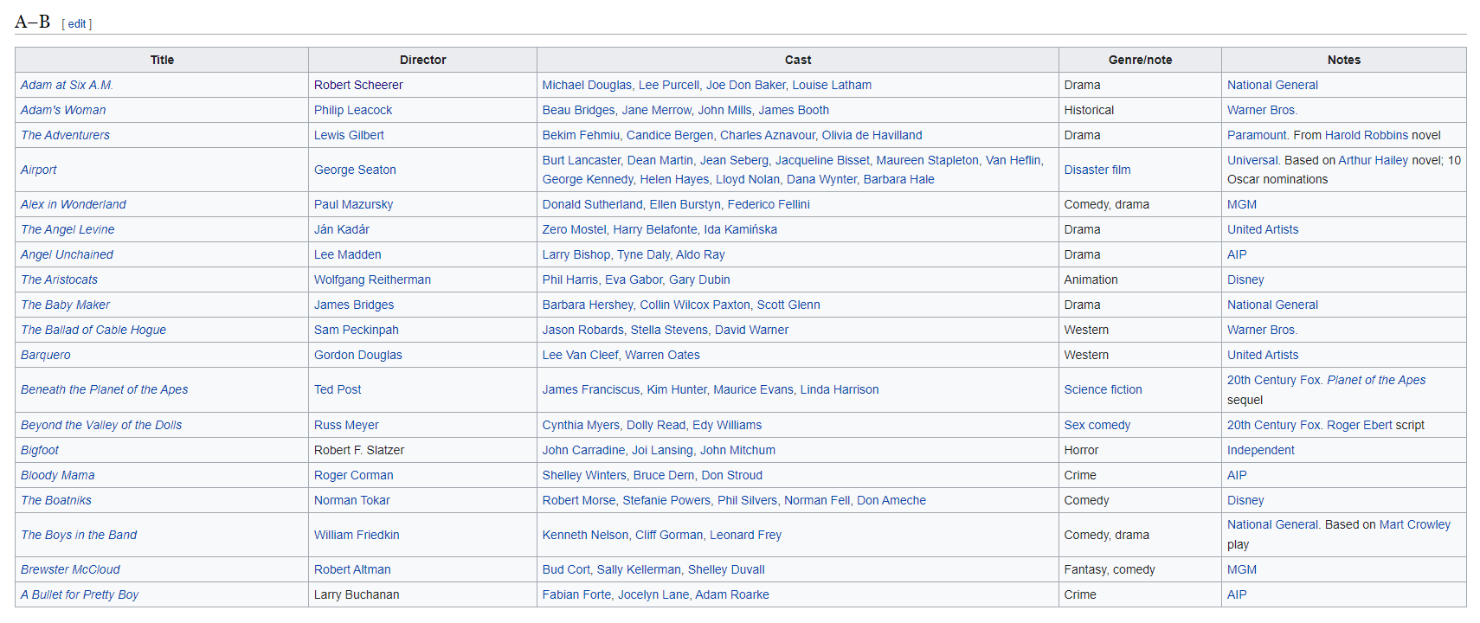
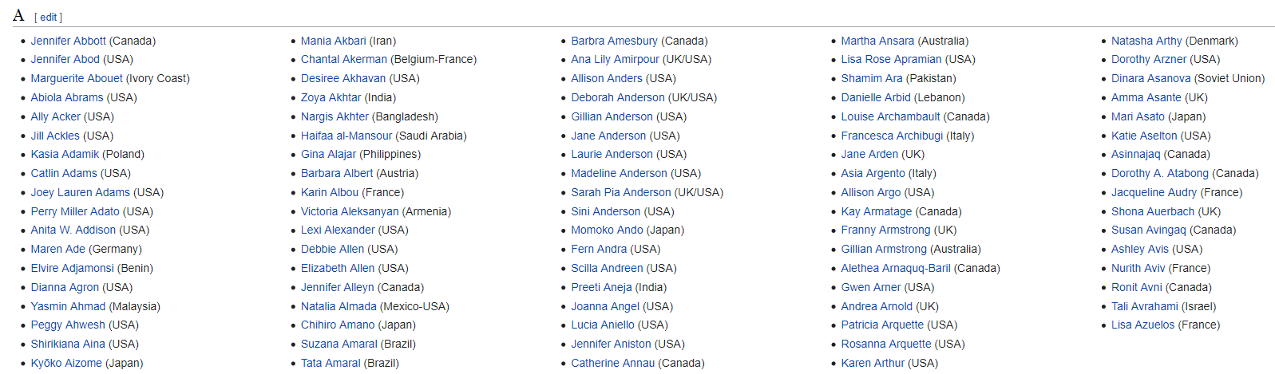


Research process- Data Acquisition
Sources
Lists of American films
IMDB Site
List of woman #1
List of woman #2
List of woman #3
List of woman #4
List of woman #5
List of woman #6

Slide 5
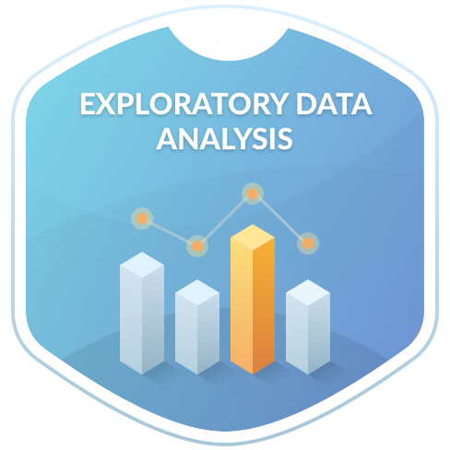
Research process – EDA
Concatenation of all the information into one table
Clean mismatch between IMDB and Wikipedia
Handling NULL Values
Handling length of movie format
Split columns

Slide 6
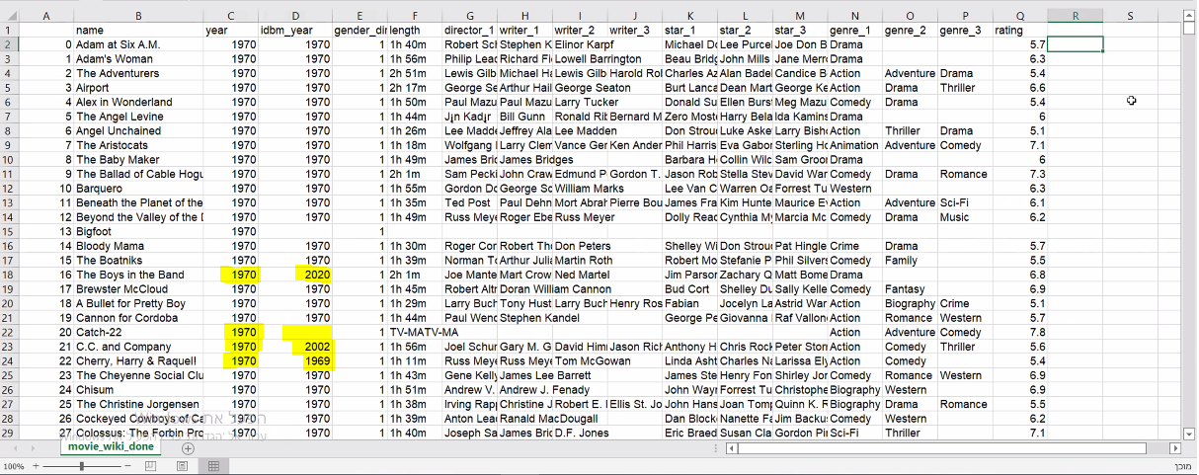
Research process – EDA
Clean mismatch between IMDB and Wikipedia
In our project there were a few mismatches between crawling from Wikipedia and IMDB.
We put all the data in one table and compare the years from Wiki to IDBM.

Slide 7



Research process – EDA
Handling length of movie format
Format of lengths:
1hr 35min
2hr
45min
We convert to uniform format – calculate to minute format

Slide 8
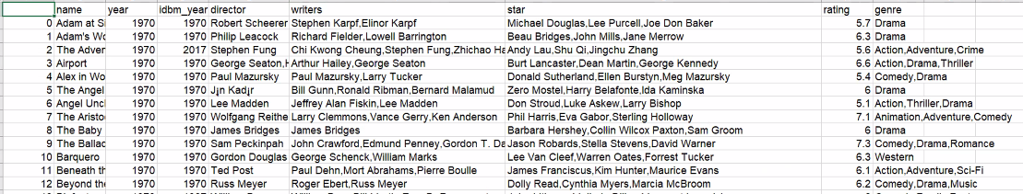

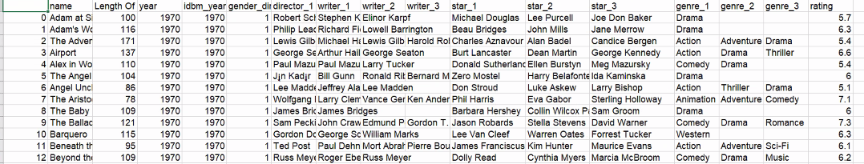
Research process – EDA
Split columns
Each multi-value feature had a maximum of 3 entries, so we split each multi-entry feature into 3 columns.

Slide 9
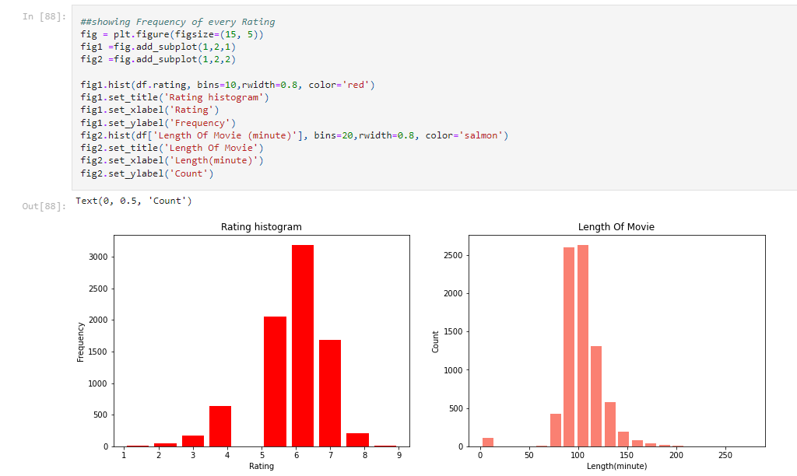
Some insights:
Movie rating distribution – as we can see
most rating of movies is average
Movie length distribution – as we can see
most length of movies is between 80 to 120

Slide 10
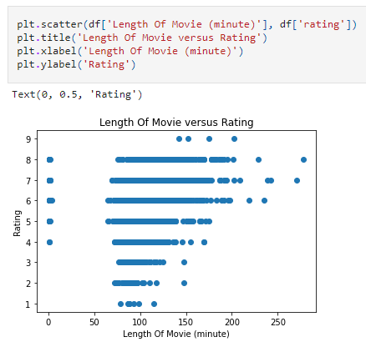
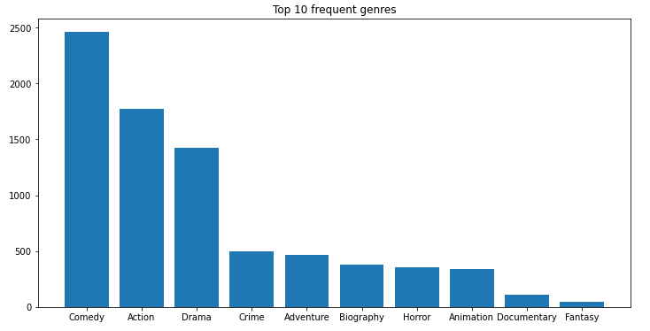
Some insights:
Top 10 frequent genres – most of movies is belong
to Comedy, Action, Drama
As we can see, there is no correlation between
length of movie and rating

Slide 11
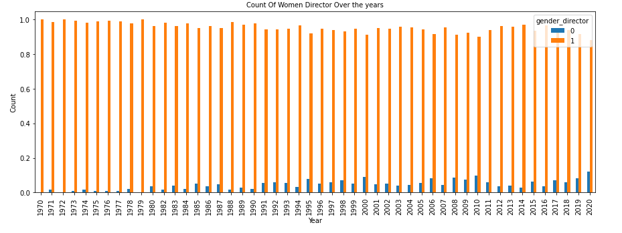
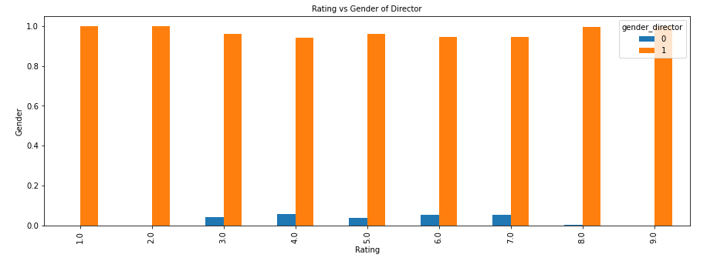
Some insights:
Over the years
it can be seen that the number of women
producing films has increased
Women's movies are generally rated average,
unlike men which are rated
On the whole scale of values

Slide 12
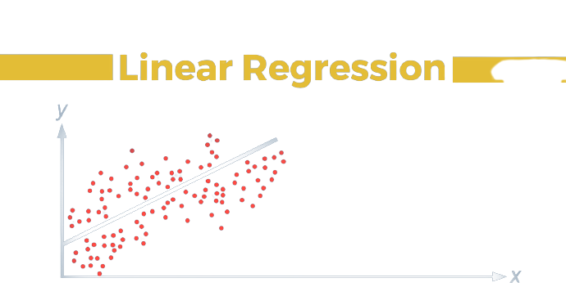
Machine Learning
Linear regression
Using the ‘sklearn’ library and linear regression we were able
to train a model that predicts the rating of movies based
on crew features. We add some columns based on our data,
that described the quality of director, writer, starts and genre.

Slide 13
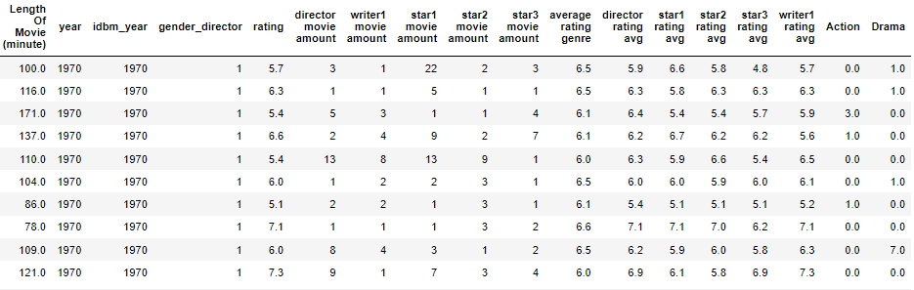

Machine Learning
Linear regression
The final table for the machine learning model

Slide 14
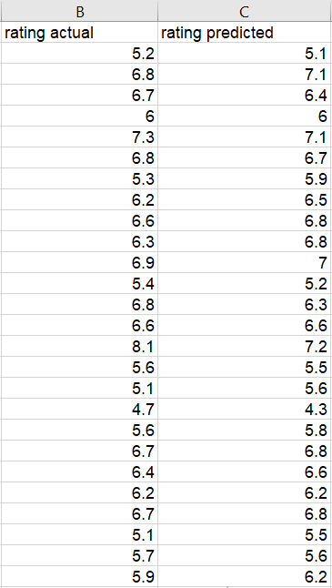
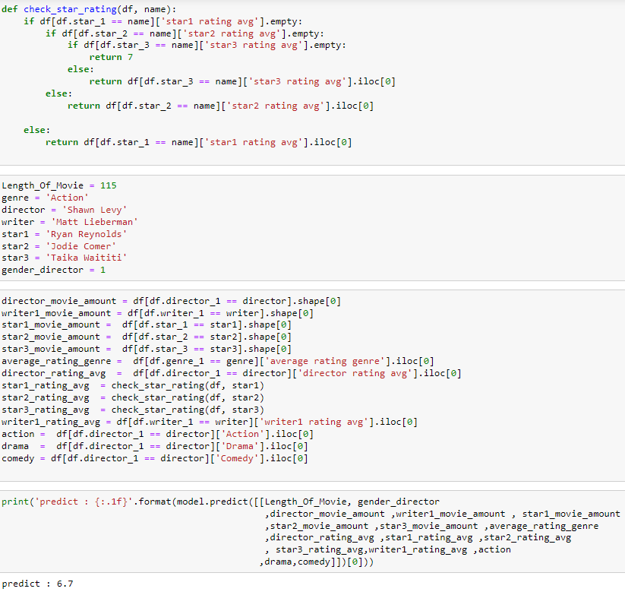
Machine Learning
The prediction rating VS versus the original rating
Example for predicting a new movie's rating

Slide 15

Conclusions
The closer the prediction value is to 1, the more accurate the prediction. We have reached a predict value of 0.874, which is very close and therefore confirms the research question.
Therefore there is a connection between the film crew and the rating!

Slide 16





Thank You
Dvir Harazi
Tsach Yashar

